Slide 1
Demographic change and memory
Stephen McNair – Vice chair
Erik Buskens - Chair
Scientific Advisory Board
JPI “More Years : Better Lives”!

Slide 2
Demography: a summary
Ageing society is a global issue
Ageing should be good news – more years, better lives
Average life expectancy is rising - but varies by education and class
Healthy life expectancy is not keeping pace
Old age dependency is a major concern – but people are working later in life (slow change)
Organisations are slow to learn how to manage the issues
Processes for transferring memory between generations are poorly developed
Incidence of dementias is rising
These issues call for multidisciplinary research

Slide 3
JPI – More years: better lives

Slide 4
JPI “More years: Better lives”
14 countries (including Canada)
Focus is on the implications of demographic change – mainly ageing
Organisation:
General Assembly – national representatives
5 specialist working groups: health & performance, social systems & welfare, work & productivity, education & learning, housing and development - >100 scientific experts
Scientific Advisory Board – chairs & vice chairs of working groups
Societal Advisory Board – stakeholder interests at European level
Fast Track projects on:
Data – multidisciplinary review of 337 current sources - completed
Retirement decision making – review of current research, policies and practice – completing end 2014
Strategic Research Agenda – published Spring 2014

Slide 5
Strategic Research Agenda
Four domains:
Quality of Life, health and wellbeing
Economic and social production
Governance and institutions
Sustainable welfare
11 Research priorities

Slide 6
Dimensions of demography trends and issues

Slide 7
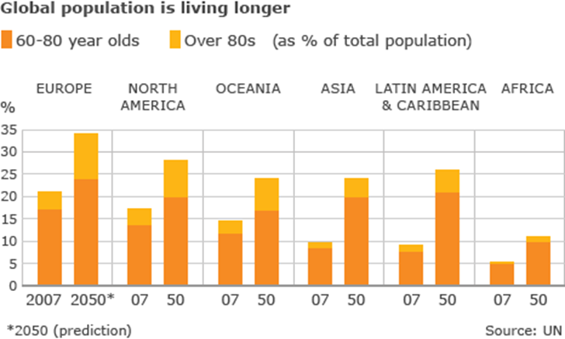
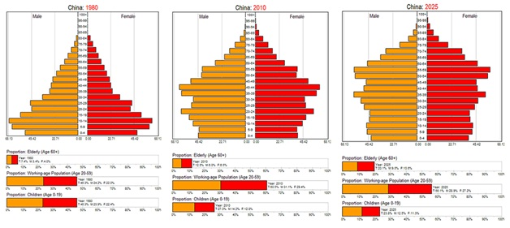
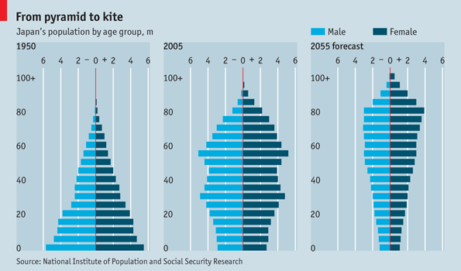
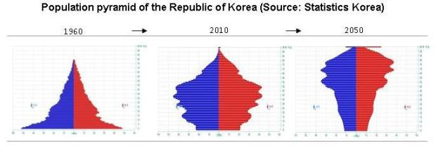
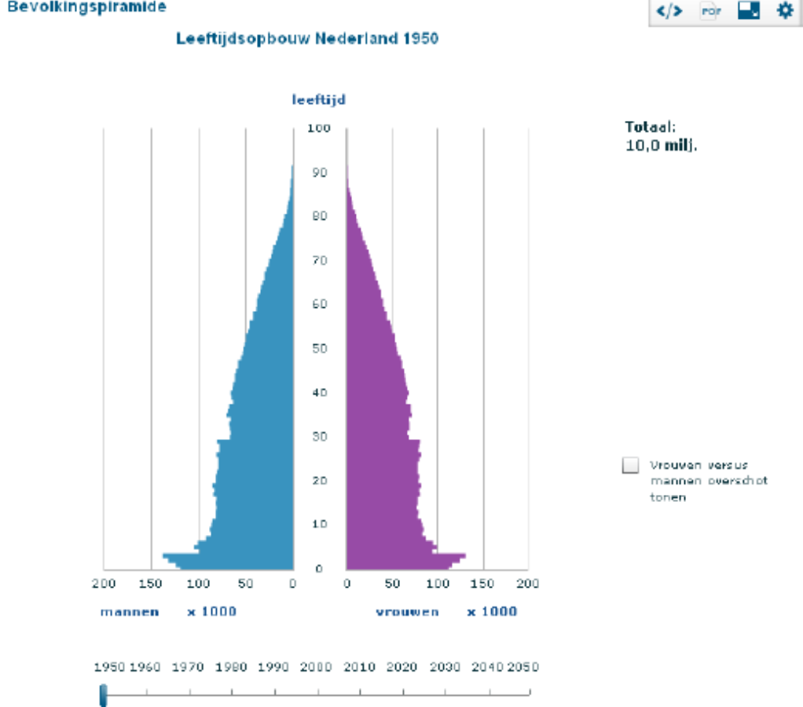
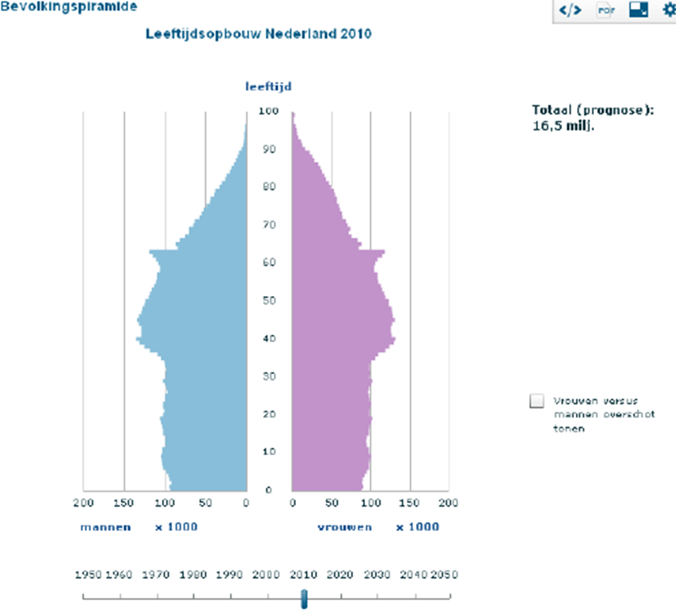
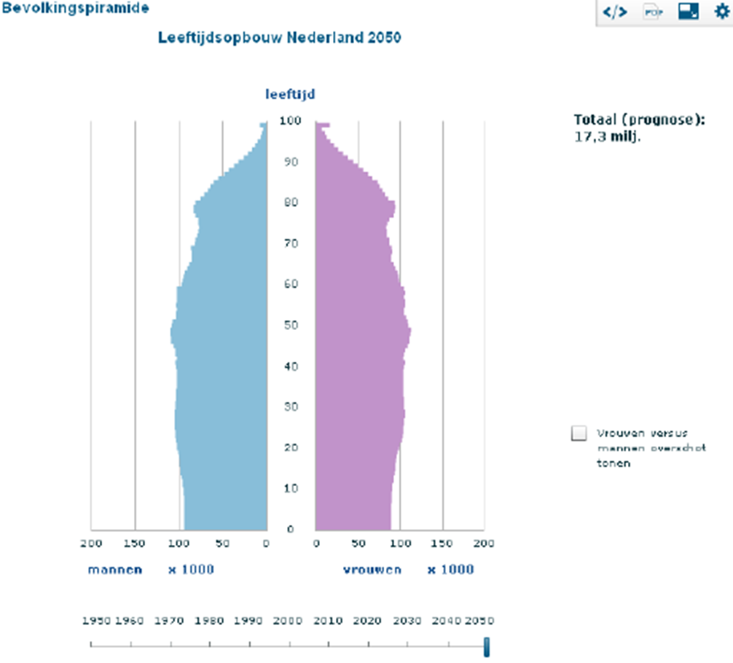
Population ageing: a worldwide phenomenon

Slide 8
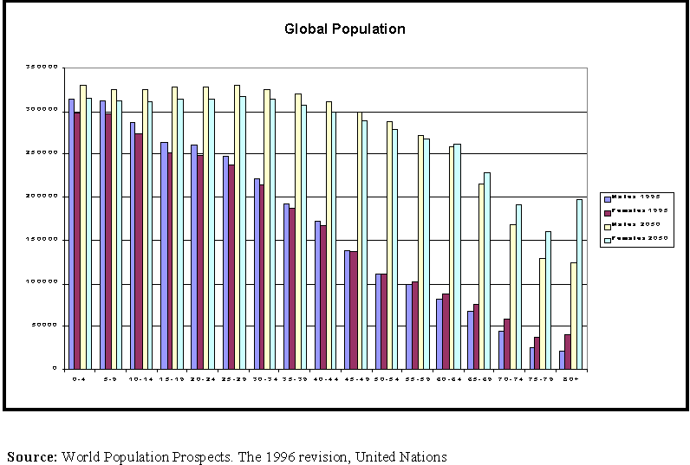
The new old age: “third” and “fourth” ages
QoL & participation
Health care costs
Labour market
Welfare
Pensions
Etc..
Cognitive decline & Dementia

Slide 9
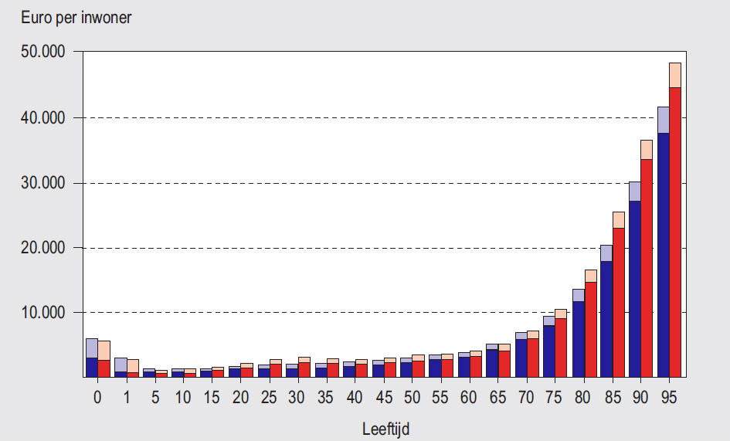
Health care expenditures
inhabitant
Age

Slide 10
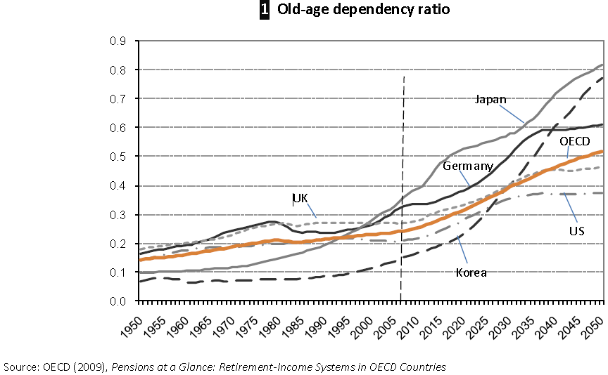
‘Old age dependency’: the policy challenge

Slide 11
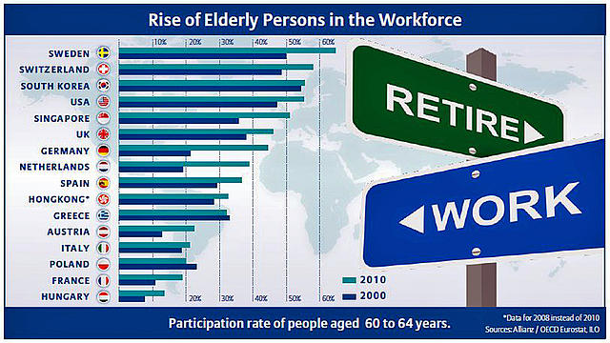
People are working longer

Slide 12
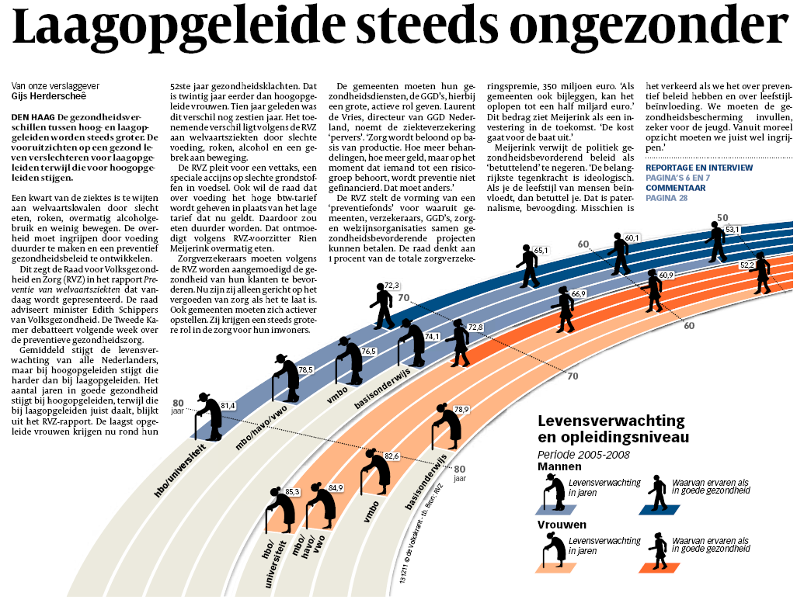
Example: Dutch life expectancy by sex and education
SES and health
Primary education
Life expectancy and
level of education
Lower vocational
Vocational
Up to college
College
and above
Poor
health
Good health

Slide 13
Memory and MYBL
Not a major focus
Three dimensions:
Individuals and memory loss - dementia
Organisational memory
Intergenerational memory

Slide 14
Healthy Ageing
a multi-dimensional strategy
Health, HRQoL etc
Societal Utility
Prevention
worst case scenario
Intervention
Age
Notes:
14

Slide 15
Individual memory: the dementia challenge

Slide 16
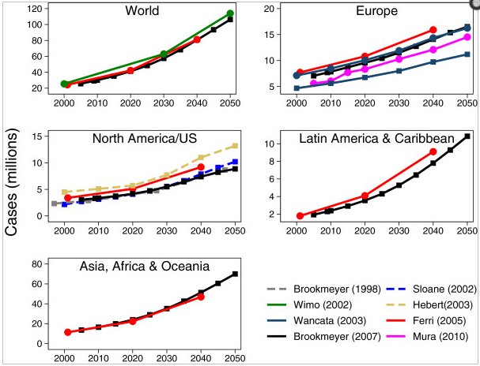
Dementia will grow as an issue general agreement

Slide 17
Dementias: modifiable risk factors
Factor | Prevalence | Risk
Physical inactivity | 31 | x 5
Smoking | 27 | x 1.5
Educational level | 27 | x 2
Midlife hypertension | 12
Midlife obesity | 7
Diabetes mellitus | 7
Norton et al.

Slide 18
Midlife fitness reduces dementia

Slide 19
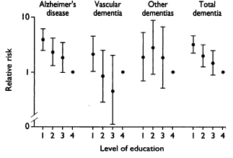
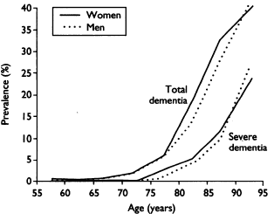
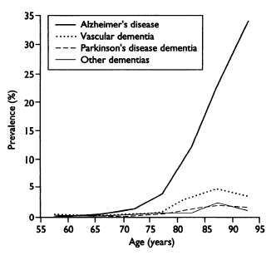
Dementia risk is related to educational level
Ott et al. BMJ 1995;310:970-3 + accompanying editorial pg. 951

Slide 20
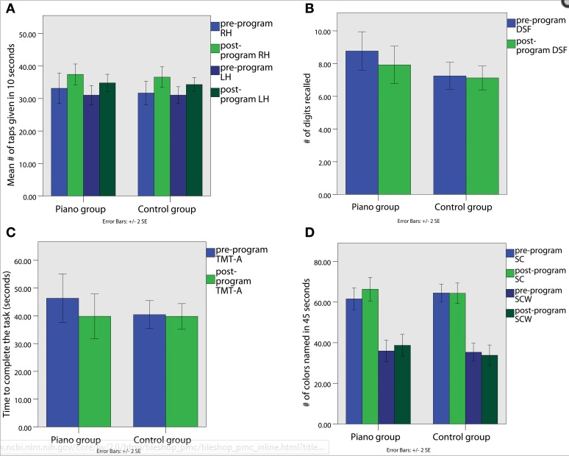
Later learning can reduce dementia Piano playing and cognitive function

Slide 21
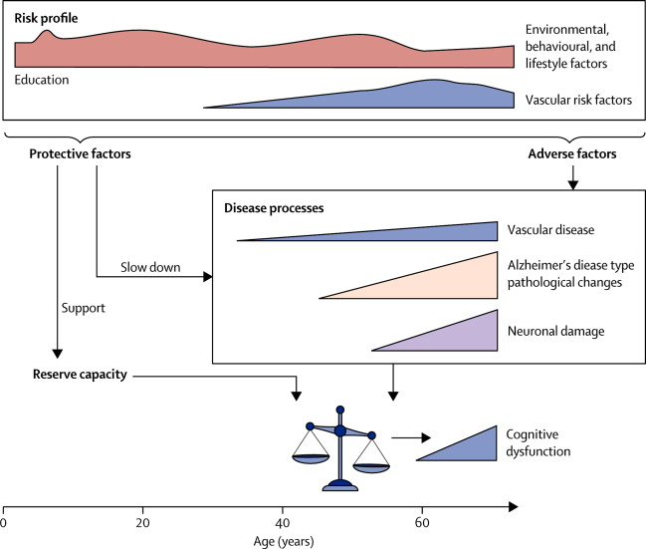
Prevention: a life course perspective
Modifiable risk factors for Alzheimer's disease across life.
Geert Jan Biessels. Capitalising on modifiable risk factors for Alzheimer's disease. The Lancet Neurology, Volume 13, Issue 8, 2014, 752 - 753

Slide 22
Organisational memory

Slide 23
Transmitting memory
Organisations lose the memory of their older workers
Banking
Computing
Nuclear engineering
Older people value transmitting their memory

Slide 24
Benefits of adult learning 50-90yrs

Slide 25
Further challenges
How to effectively manage established dementia
How to develop effective preventive strategies– first signs of succesful public health strategies?
How to understand the impact of mild cognitive impairment on information rich society
Strategies for intergenerational transfer

Slide 26
Optimistic trends yet prevalence will increase due to ageing
Rocca WA, Petersen RC, Knopman DS, Hebert LE, Evans DA, Hall KS, Gao S, Unverzagt FW, Langa KM, Larson EB, White LR. Trends in the incidence and prevalence of Alzheimer's disease, dementia, and cognitive impairment in the United States. Alzheimers Dement. 2011 Jan;7(1):80-93.
Schrijvers EM, Verhaaren BF, Koudstaal PJ, Hofman A, Ikram MA, Breteler MM. Is dementia incidence declining?: Trends in dementia incidence since 1990 in the Rotterdam Study. Neurology. 2012 May 8;78(19):1456-63.
Qiu C, von Strauss E, Bäckman L, Winblad B, Fratiglioni L. Twenty-year changes in dementia occurrence suggest decreasing incidence in central Stockholm, Sweden. Neurology. 2013 May 14;80(20):1888-94.

Slide 27
Thank you for your attention!
Stephen.Mcnair@niace.org.uk
e.buskens@umcg.nl
Let’s play!

